Slide 1
Fitness App Clone
Popular app to track physical activity
Vijay Dhakal

Slide 2
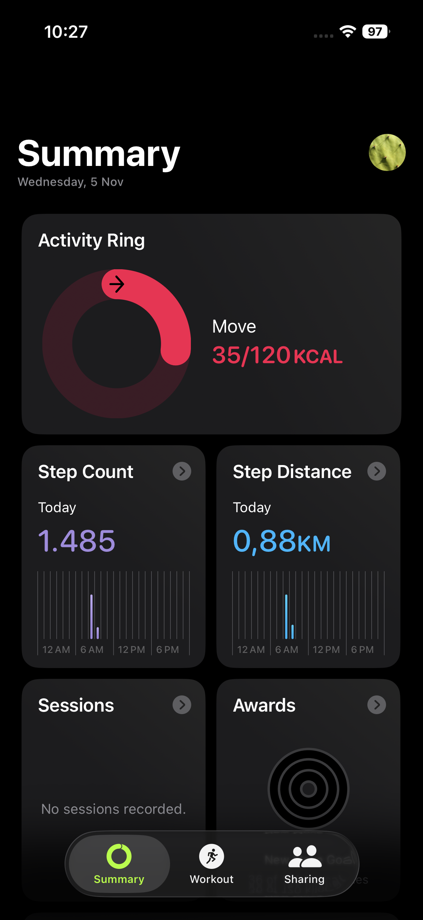
Navigation Title
Button
Button
Icon
Tab bar

Slide 3
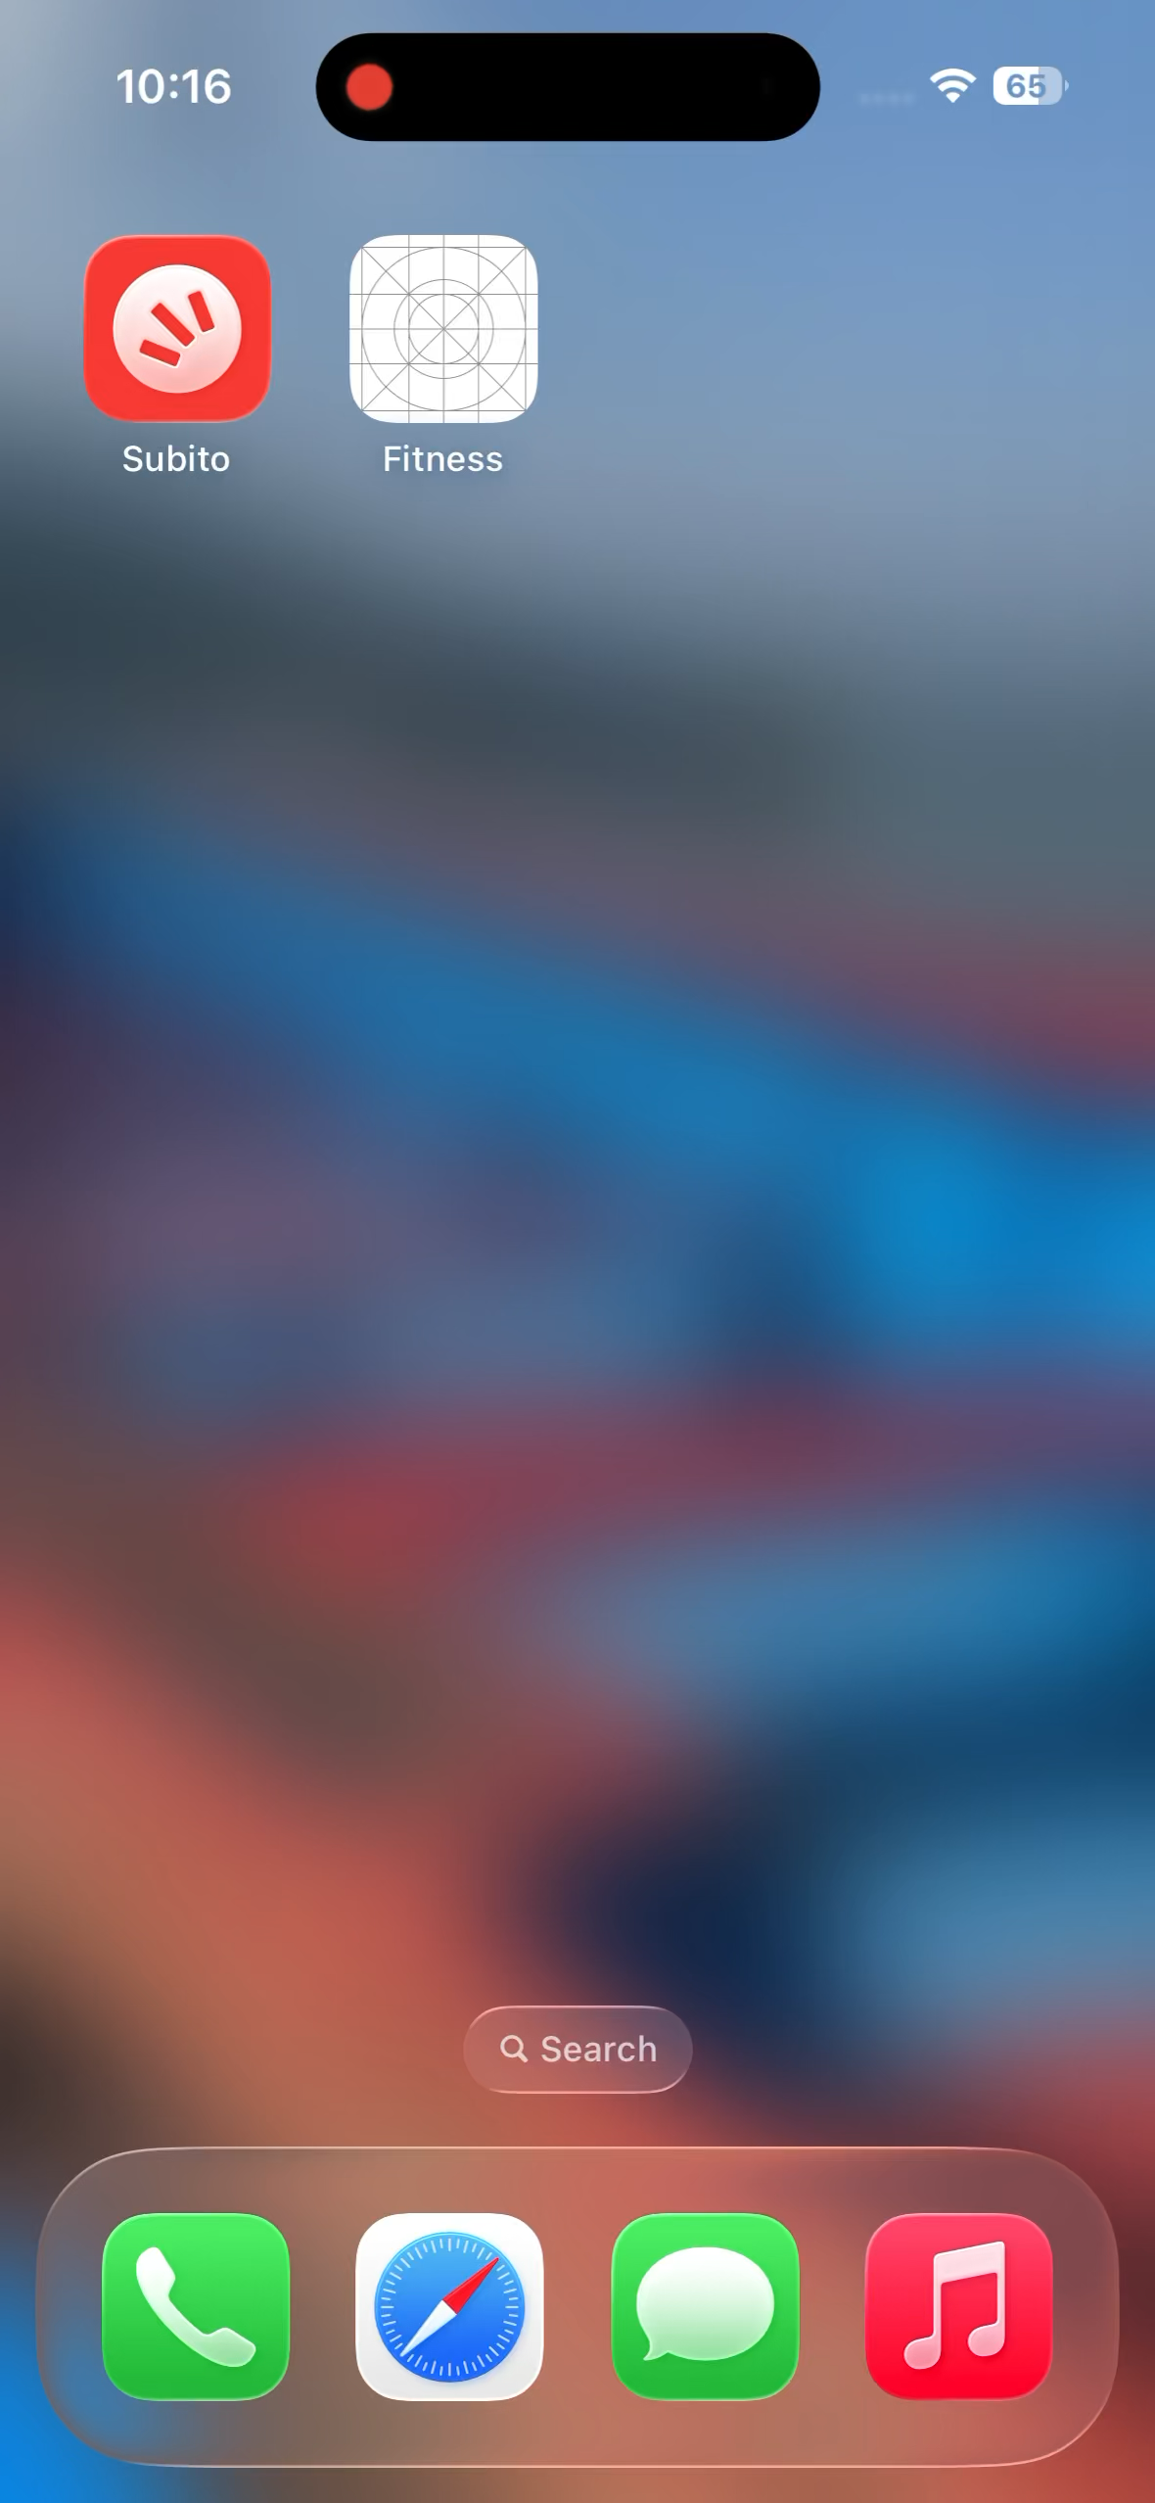

Slide 4
Challenges
Complex UI Animation
Recreating pixel-perfect, responsive components (nav bars, charts)

Slide 5
Key Learning
UI/UX Insight:
Collection of micro-decisions about hierarchy and user psychology.
Technical Skill:
Advanced styling, layout techniques, and implementing complex UI animations.

Slide 6
Thank You

